Slide 1
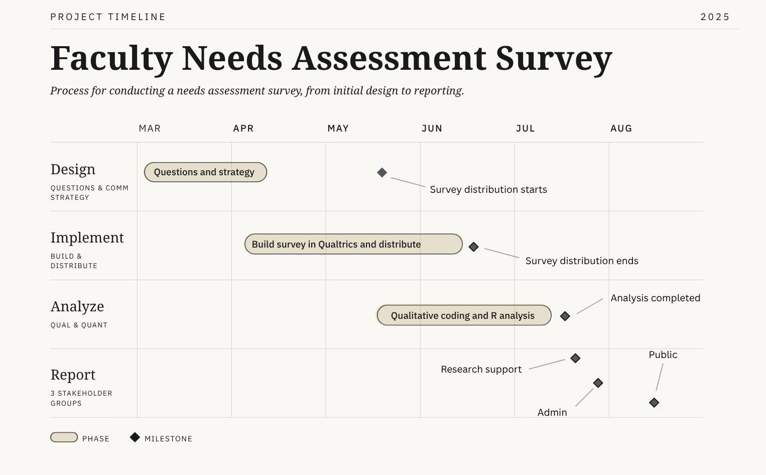
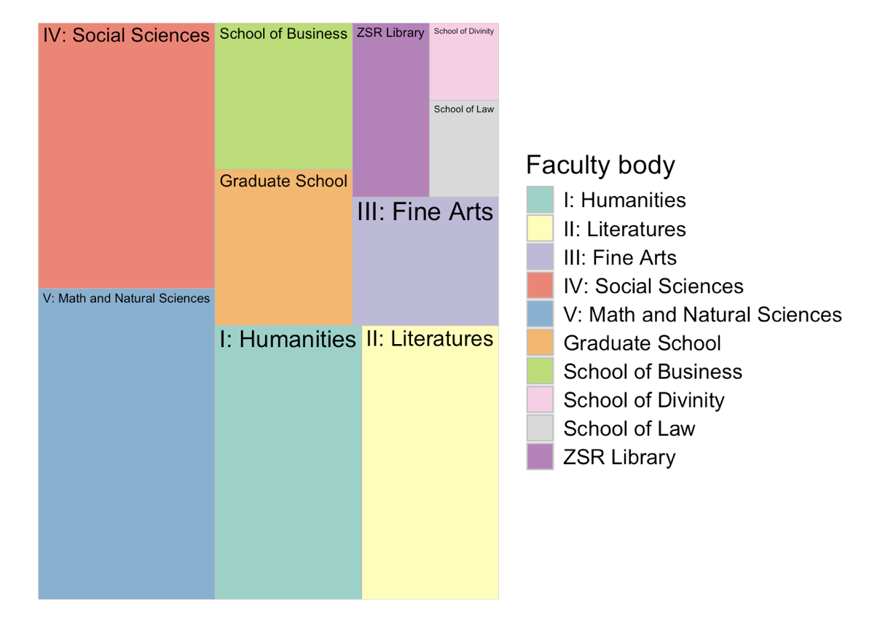
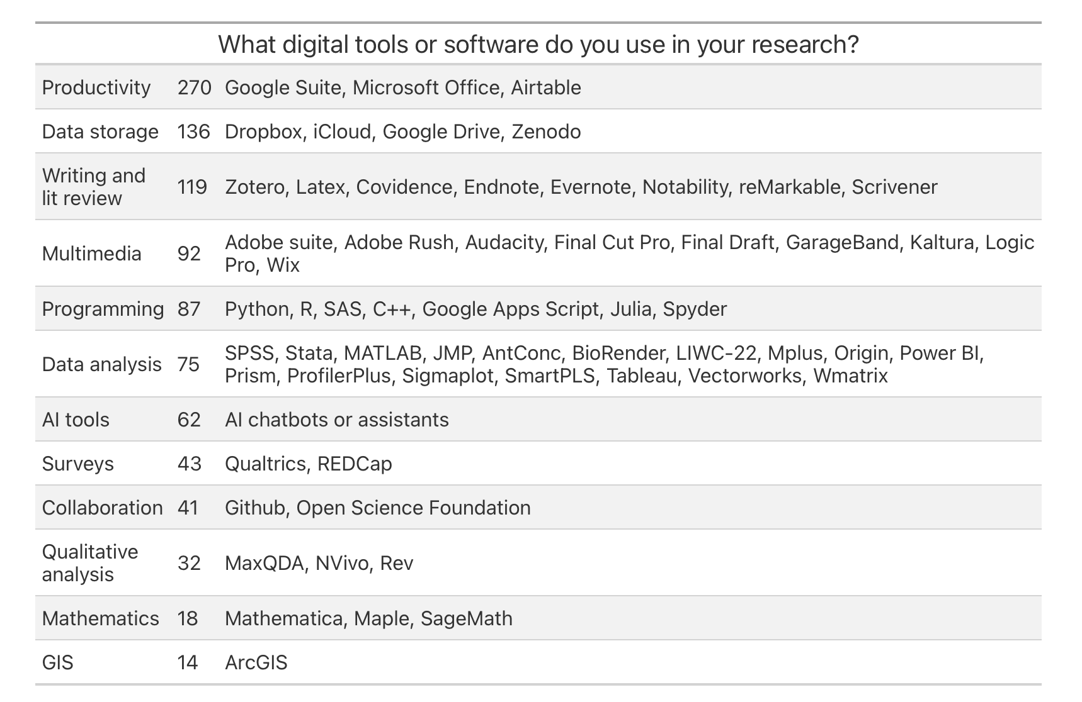
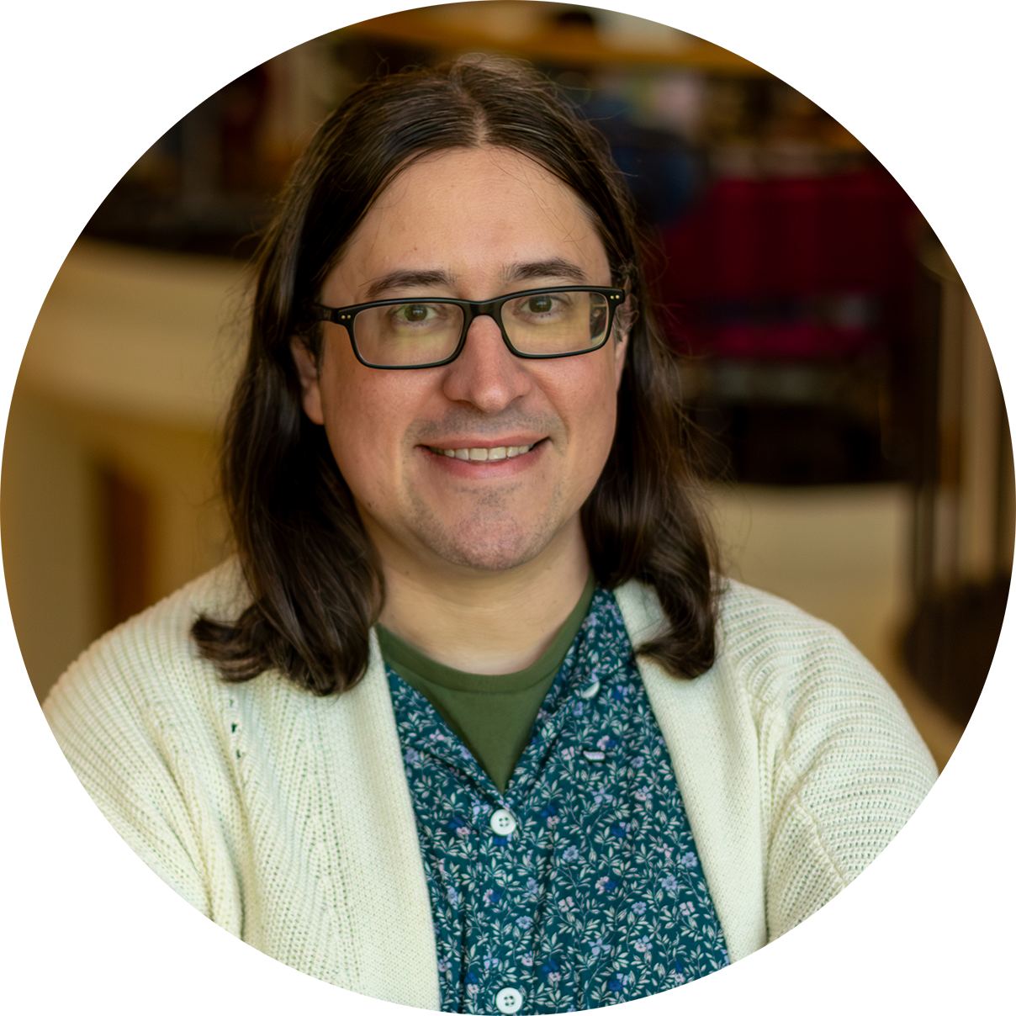

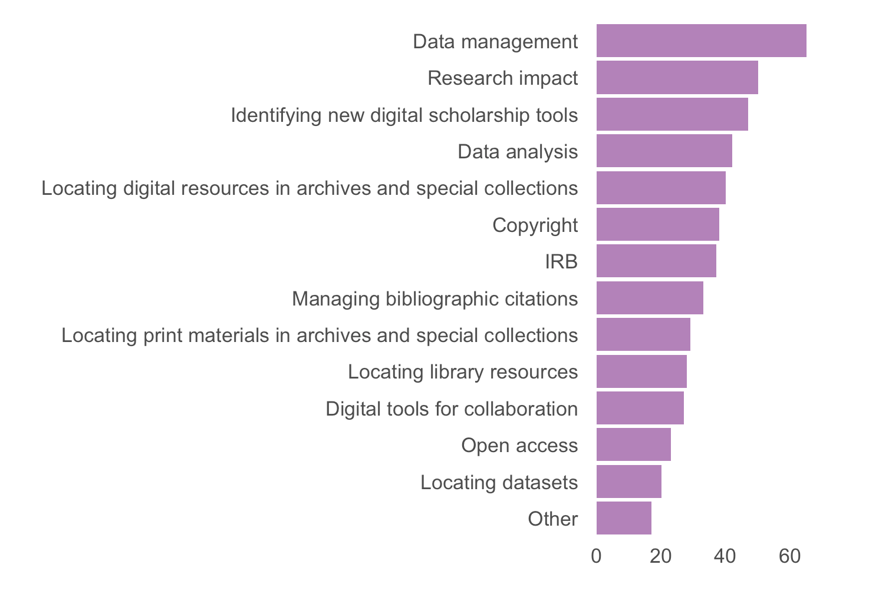
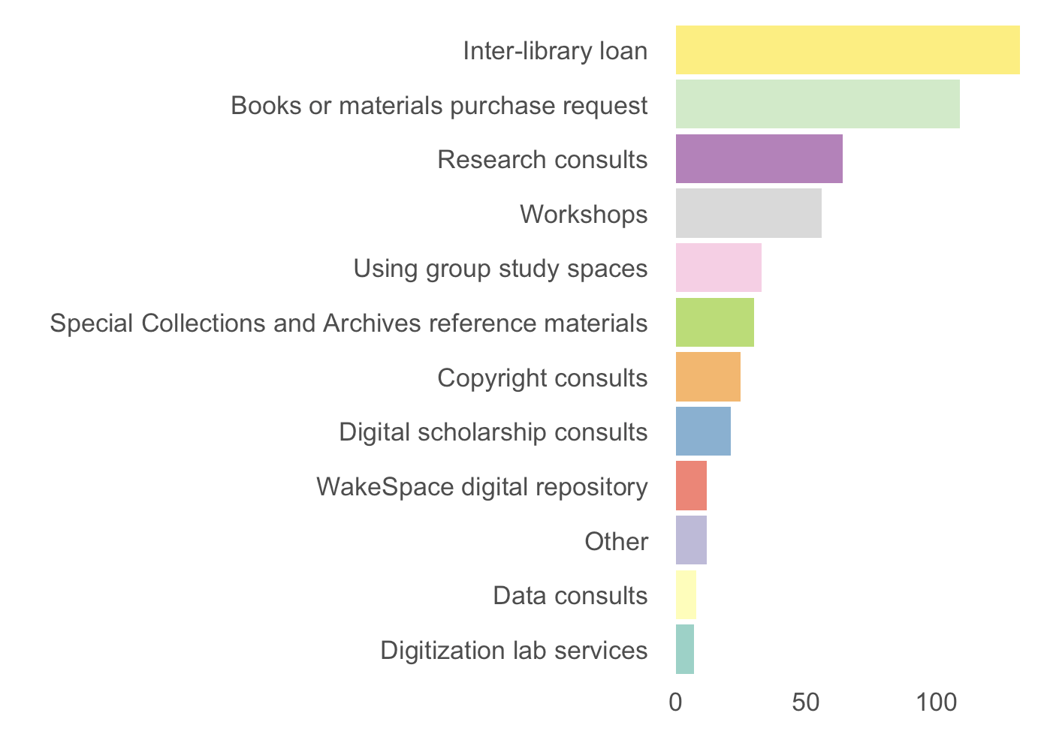
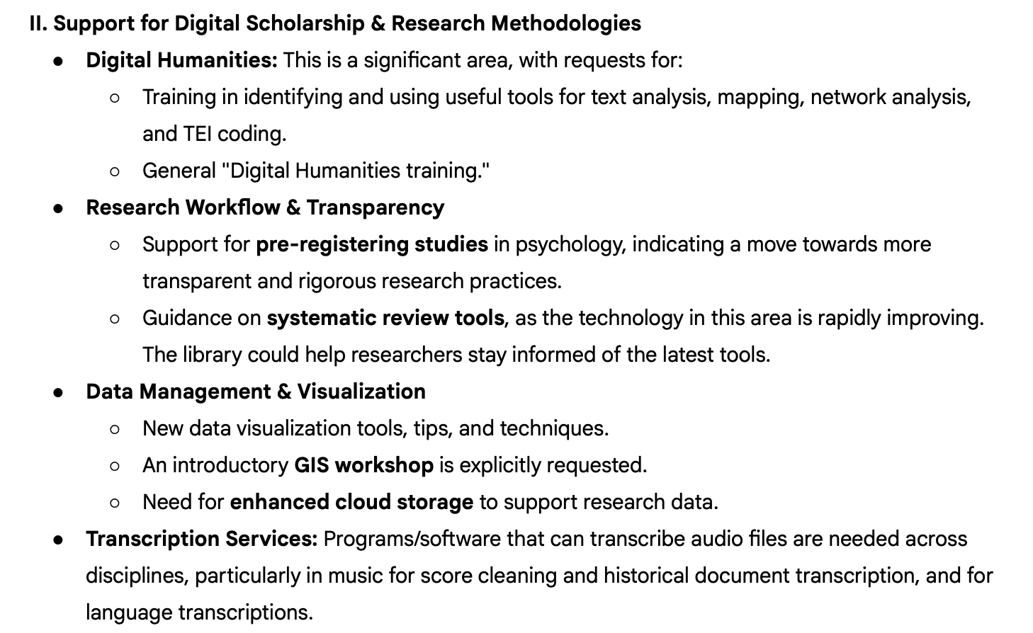
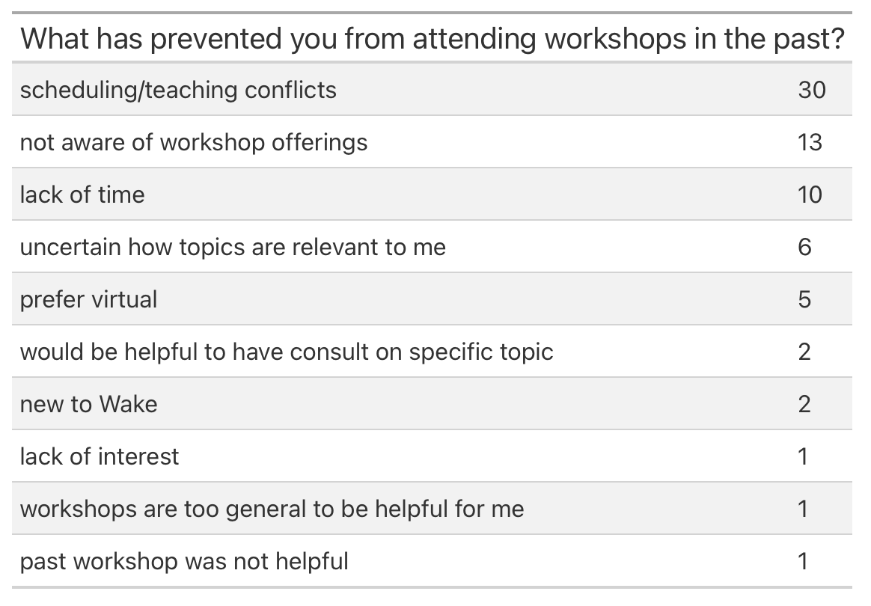
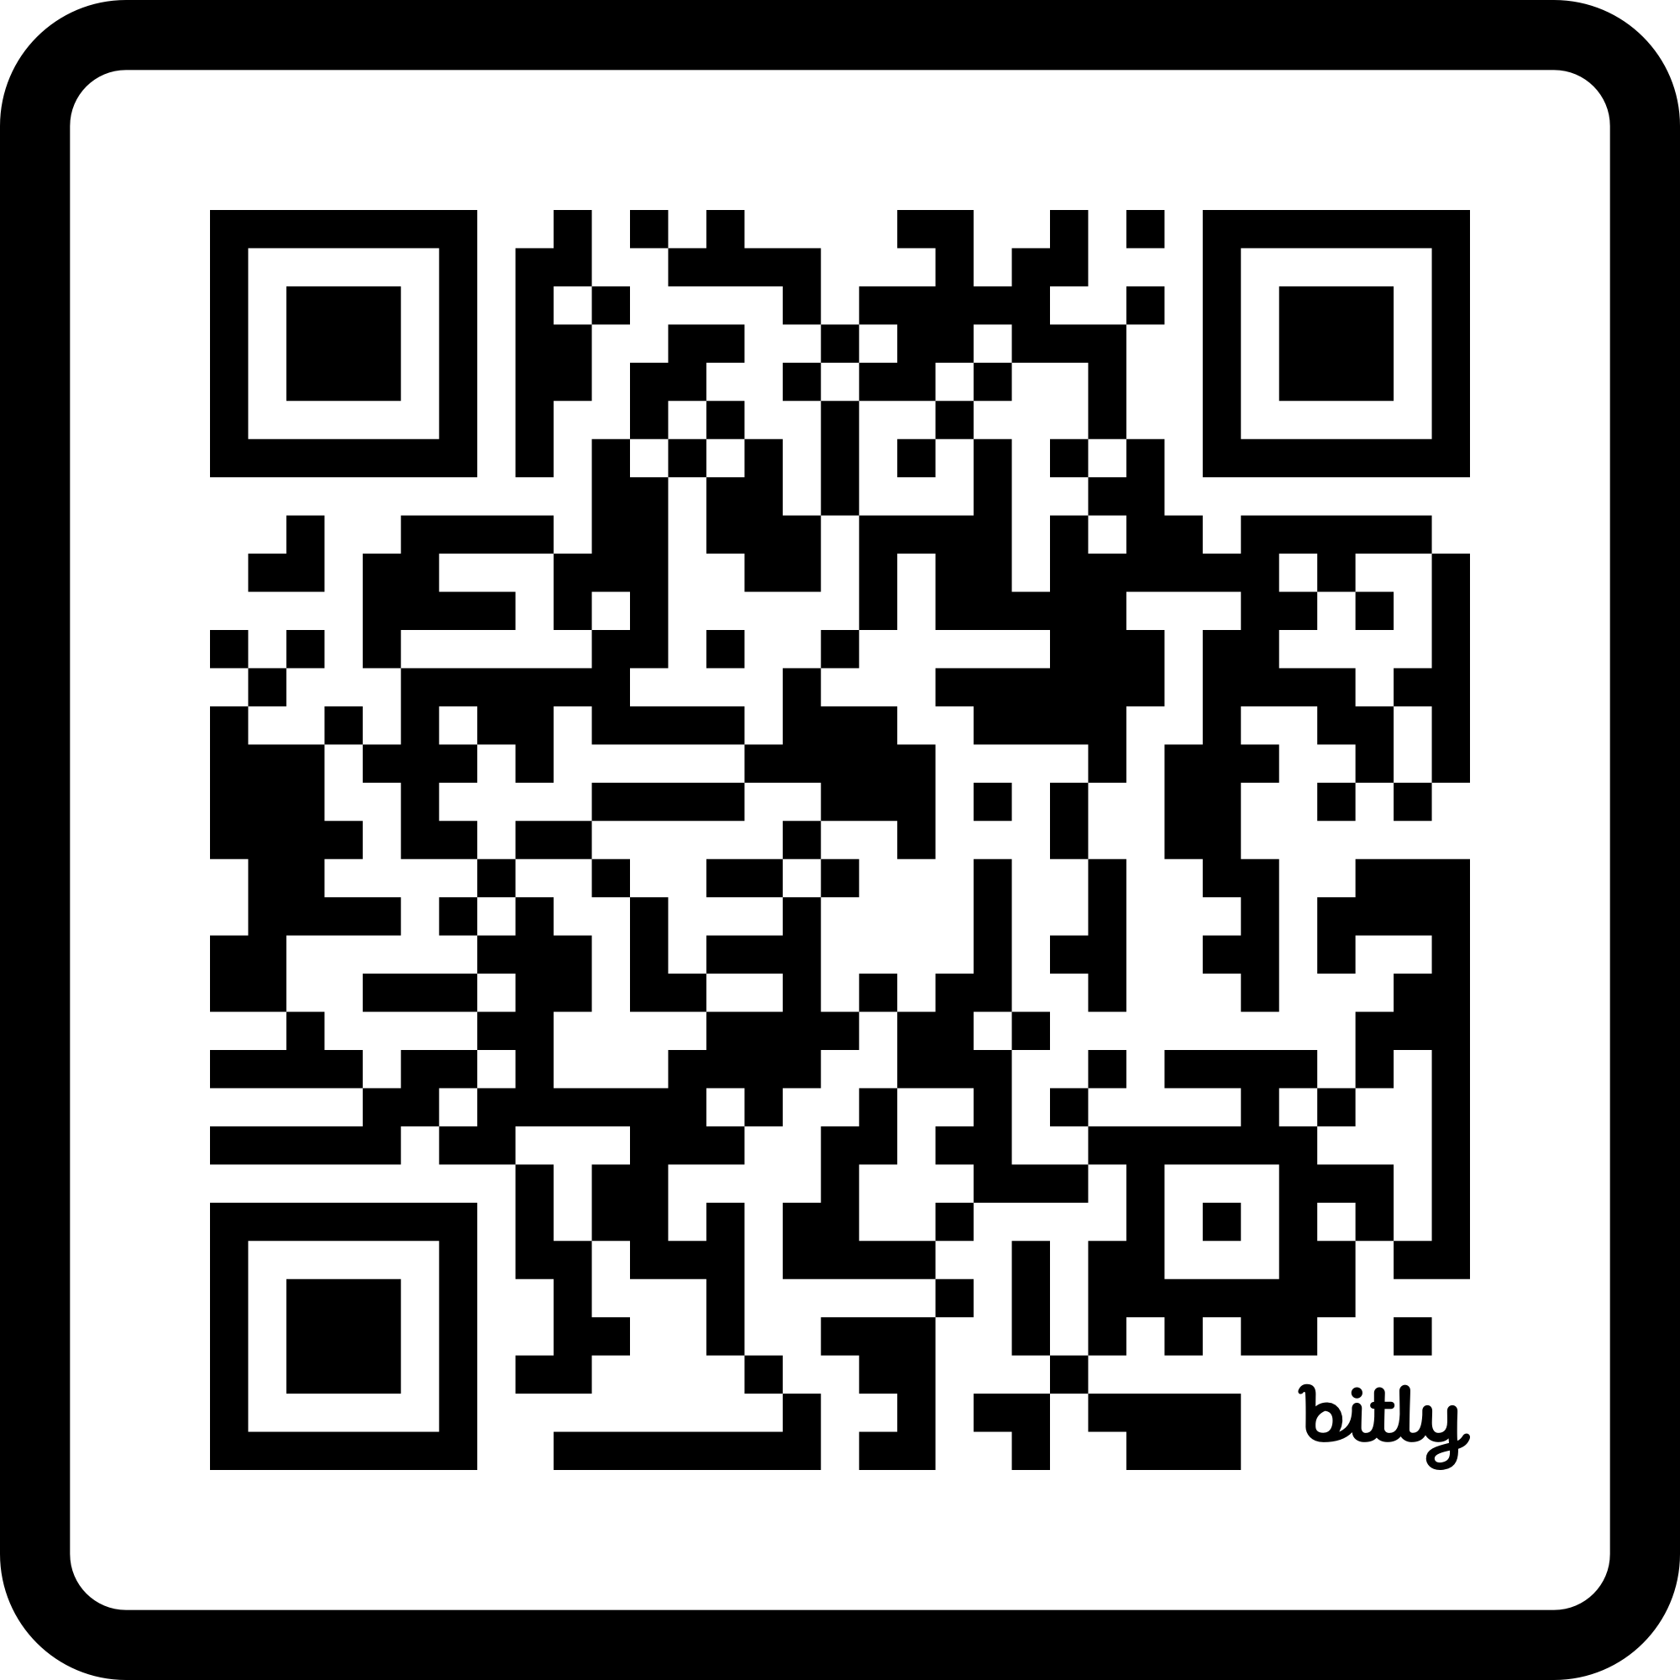


Establishing responsive data services: Conducting a data services needs assessment for university faculty
Key survey question tables and charts
Joddy Marchesoni
Data Services Librarian
marchej@wfu.edu
Takeaways
Software tools
How do you discover what faculty at your institution need from your department? Ask them!
Our approach involved using data analysis skills (R and MaxQDA), but built-in tools work great for simpler survey designs!
Design your survey carefully – you can’t go back and change it once the survey begins.
Develop a communication plan before distributing the survey. Know who your stakeholders are and get their input throughout the process.
Tables and charts are great for telling a story. Keep the visuals consistent across questions.
Qualtrics platform for mixed mothods survey design and distribution
R and Rstudio for quantitative data analysis & visualization
  Tidyverse packages for data preparation
  qualtRics package for accessing Qualtrics data
  gt package for tables
  treemapify for treemap visualizations
MaxQDA to code qualitative data
Quarto in Rstudio for generating reports with text, tables, and charts
  Export to HTML, PDF, Word
Github for hosting project code
Report stakeholders
Group | Roles | Survey visibility | Comm strategy
Admin | Administrative council – library dean, directors | All content, including non-aggregated responses | Led Admin Council meeting: shared results and recommendations
Research support | Liaison librarians, provost’s office, research services team | All aggregated content, “Other” free responses, no qualitative open-ended answers | Made report available as HTML page, responded to email feedback
The public | Faculty, staff, students, blog readers | Only aggregated content, no free response answers | Wrote public blog post and created public GitHub repo with HTML and code
Abstract
As the first Data Services Librarian at ZSR, I conducted a needs assessment to design our brand-new services for faculty support across many disciplines. With input from my department, I designed and ran a mixed-methods faculty research services survey delivered to campus faculty in Summer 2025. The survey provided us with a rich illustration of where faculty need support and kept service scoping and prioritization responsive to demonstrated needs. I created reports to share the results with my department, library directors, and the library as a whole. In this talk, I will discuss how we determined the survey questions and the tools we chose (Qualtrics, MaxQDA, and R), and how the assessment results informed our strategy for the following year. I will also share some of the materials from the process to help illustrate how to conduct a similar assessment at other institutions.
Context and motivation
Public repository for survey code and report
Establishing data services at ZSR
When I arrived at ZSR Library in Feb 2025, I was the first Data Services Librarian, in the Digital Initiatives & Scholarly Communication (DISC) department. One of my initial goals was to determine faculty research service needs. There are nearly 1,000 faculty members across 6 schools and 5 Arts & Sciences divisions. The most effective way to reach them would be a comprehensive survey, with potential follow-up with individuals who opted in. I started designing a survey with the help of my department (Molly Keener and Kyle Denlinger).
Strategic impact and followup
Lessons learned
Building a communication plan for stakeholders
Provided evidence-based strategy for the new library dean and library directors
Established baseline needs and scoped service for first year
Direction for growth: research support services (RDM, RIM)
Potential for detailed, semi-structured interview followups
Rerun survey every few years and compare results, stay up to date with trends in research fields
Coding took significant time and effort
  Worth it for strategic planning and future surveys
Process took almost 6 months – budget time to ensure success
Would have been helpful to have a plan for assessing service success one year on
  Any ideas for how best to achieve this?
We determined three primary audiences to report to: admin (administrative council including directors and dean), research support (research/liaison librarians and provost’s office), and the public (WFU faculty, staff, students and readers of our blog). Each audience would receive a separate report and communication strategy.
Public repository hosted on GitHub
Click the green <> Code button to download the project
Poster presentation file is here
Report HTML file in render folder opens in browser
Link to public blog post in the Readme
Determining takeaways
bit.ly/wfu-fs-gh
The goal for DISC was to discover high-level research support needs, so that we could act on the findings to prioritize service rollout for 2025 - 2026.

